Slide 1

Elevator Movement Anomaly Detection:
Building a system that works on many levels
A Presentation for Technical Safety BC
Archana Subramanian, Asha Tambulker, Carmen Riddel, Shreya Shetty
Professional Master’s in Computing Science Big Data- Simon Fraser University

Slide 2
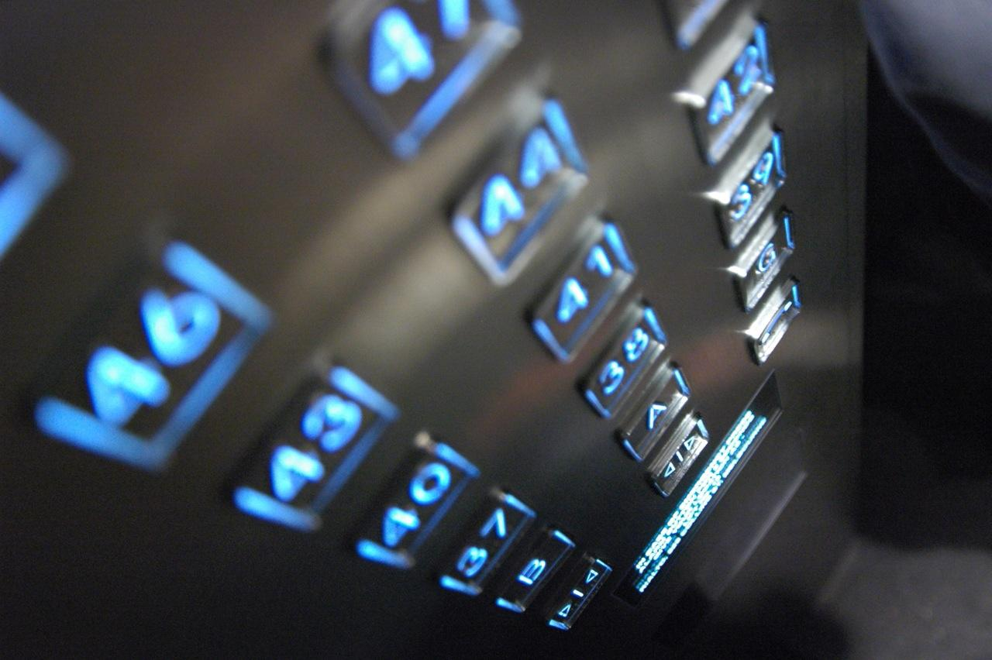
Why we chose this project
Internet of things (IOT) is a very exciting field and its use with sensor data has many use cases
As elevator incidents are on the rise in Canada, our results may help to monitor elevator health, prevent serious injuries, and may even prevent fatalities
Challenges involved
Sensor data, requires extensive research
Large amount of data from different types of elevators
Unlabeled data, hence no formal way to evaluate findings
This Photo by Unknown Author is licensed under CC BY-SA

Slide 3

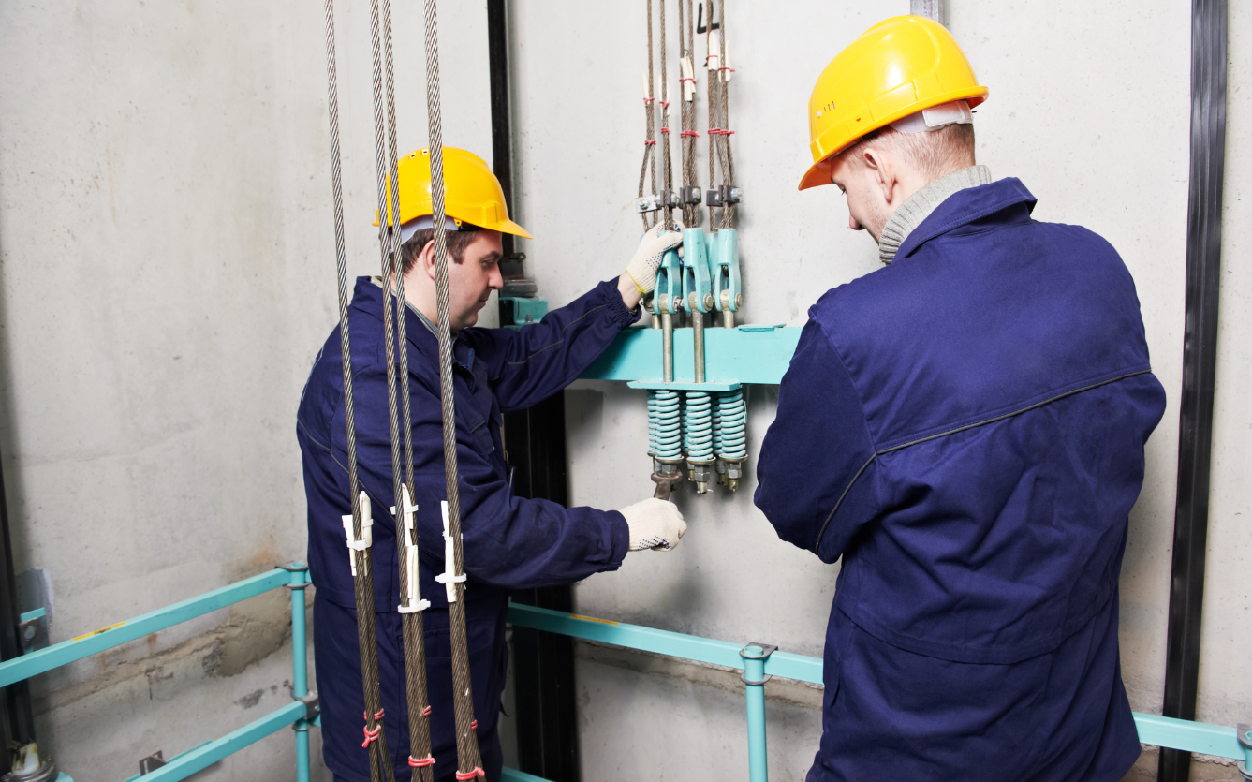
Problem Statement
1.How can we use IOT and machine learning to predict when elevators may require maintenance?
2.How can results be presented in real-time?
Who cares?
Useful for building owners
to monitor the status of the elevators
Technical safety contractors to ensure the quality & safety of the elevators over the foreseeable future without incurring additional human resource or financial cost
This Photo by Unknown Author is licensed under CC BY-SA

Slide 4
Methodology
Data Collection
Modelling
Phase I
Data Cleaning
Evaluation
Phase II
EDA
Visualization
This Photo by Unknown Author is licensed under CC BY-SA

Slide 5
Tools Used
Spark for data processing
Keras/Tensorflow - Easy to build sequential models, easy GPU usage
Arundo’s ADTK for vibration modelling
Matplotlib, Seaborn and Plotly for plotting and visualization
Plotly Dash for data streaming
This Photo by Unknown Author is licensed under CC BY-SA

Slide 6
Data Science Pipeline
Identify & rename primary axis
Reorient axis which were on the negative axis
Z normalization
Filter out data in provided date range
Apply Butterworth filter for noise reduction
SAX Enocoding
Understanding data by visualizing the cleaned data
Compare different elevators
LSTM Encoder/Decoder to detect anomalies
ADTK/XGBoost with mixed results
Compare with TSBC normal/anomalies and other literature
Build a streaming dashboard with Plotly Dash
Three-axis acceleration data from 15 different elevators
Data Collection
Data Cleaning
Data Analysis/EDA
Modelling
Evaluation
Visualization
Change model/tune parameters
This Photo by Unknown Author is licensed under CC BY-SA

Slide 7
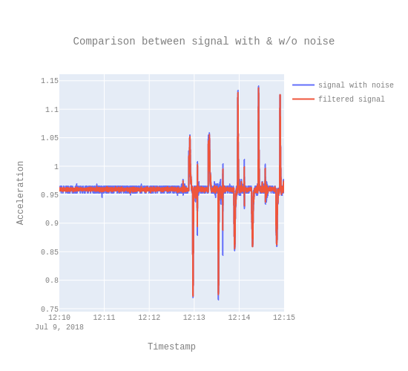
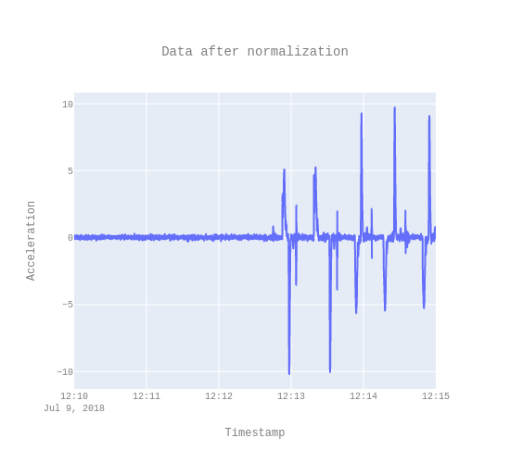
Data Cleaning
Low pass Butterworth Filter
Z- normalization
This Photo by Unknown Author is licensed under CC BY-SA

Slide 8
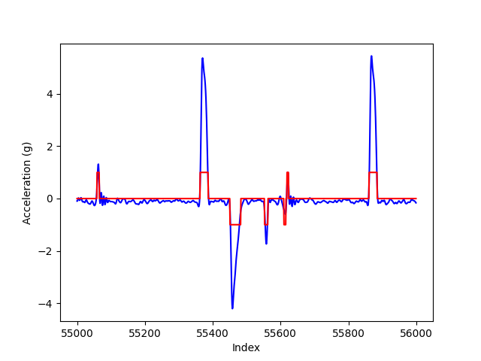
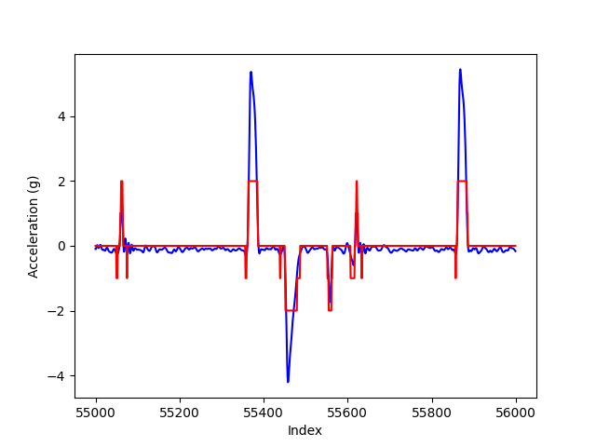
As our original LSTM seemed to be too focused on the numerical variation of the data rather than patterns, we implemented SAX encoding
SAX Encoding
Alphabet 3 SAX Encoding
Alphabet 5 SAX Encoding
This Photo by Unknown Author is licensed under CC BY-SA

Slide 9
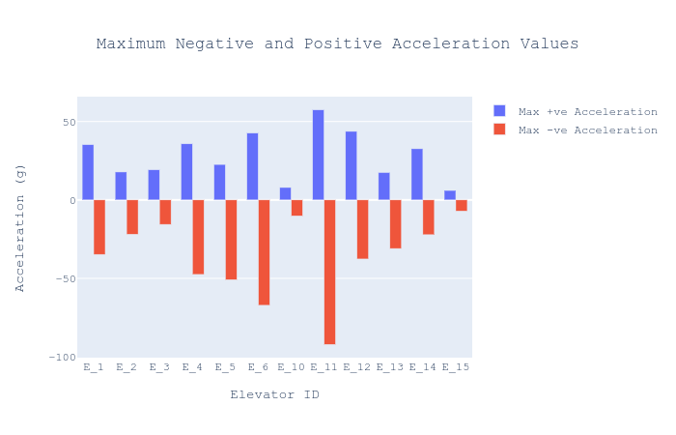
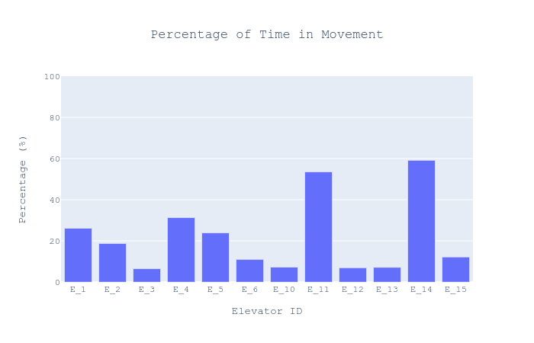
EDA Results
The dataset consisted of a number of different types of elevators, with varying maximum acceleration and varying amounts of time spent in movement. The graph on the right was calculated by SAX encoding the primary axis and taking the number of 1/-1 values divided by the total.
This Photo by Unknown Author is licensed under CC BY-SA

Slide 10
ADTK (Anomaly Detection Toolkit) and XGBoost - detected anomalies as variance off of zero (i.e., any movement was an anomaly)
LSTM Encoder/Decoder - also had this issue, until we used SAX encoding
Uses previous timesteps to predict value for current timestep - larger difference is larger error
Anomaly based on error with given threshold
Models for Anomaly Detection
This Photo by Unknown Author is licensed under CC BY-SA

Slide 11
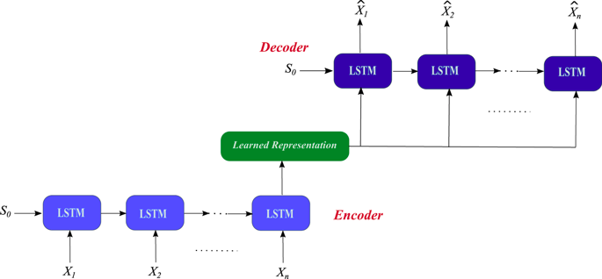
Models for Anomaly Detection
LSTM Encoder/Decoder Architecture
https://www.nature.com/articles/s41598-019-55320-6
This Photo by Unknown Author is licensed under CC BY-SA

Slide 12
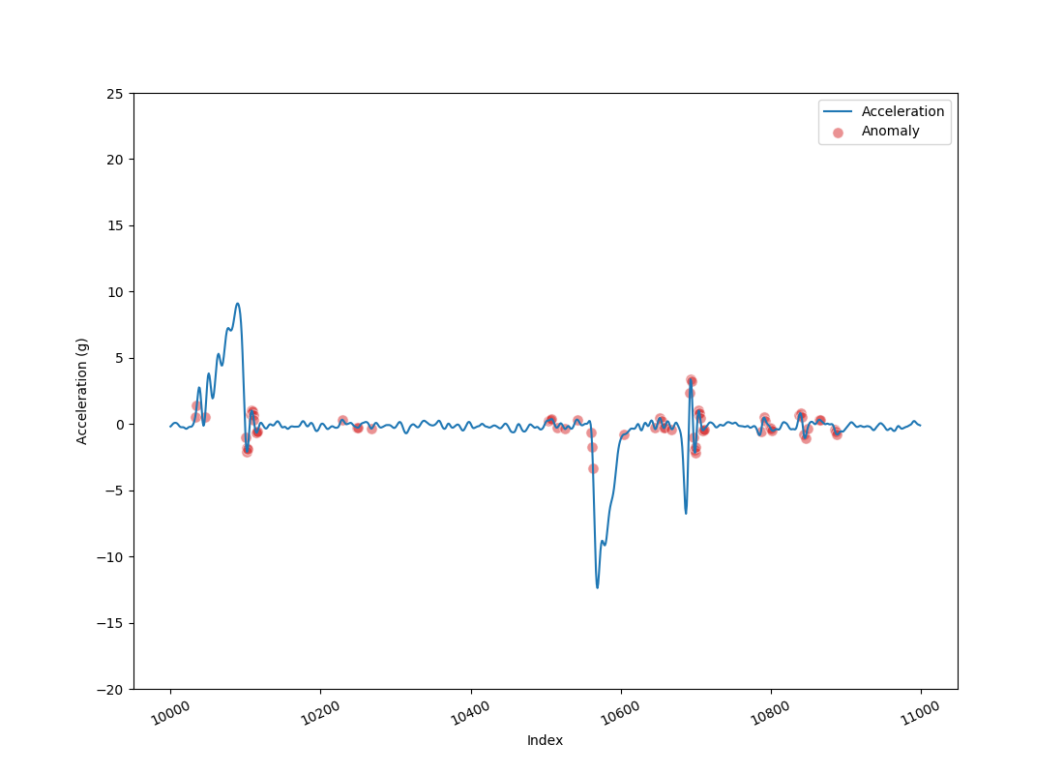
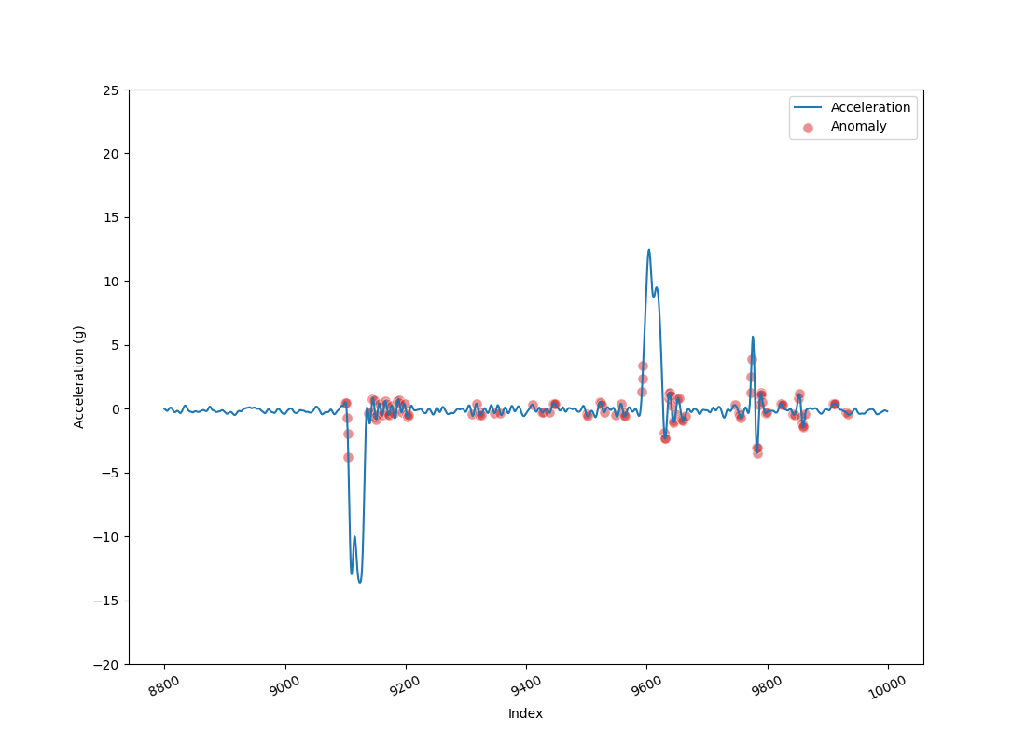
Results and Evaluation
It was refreshing to see the large jumps in acceleration caused by trips not classified as anomalies, while the erratic movement as the acceleration normalized to zero were.
This Photo by Unknown Author is licensed under CC BY-SA

Slide 13
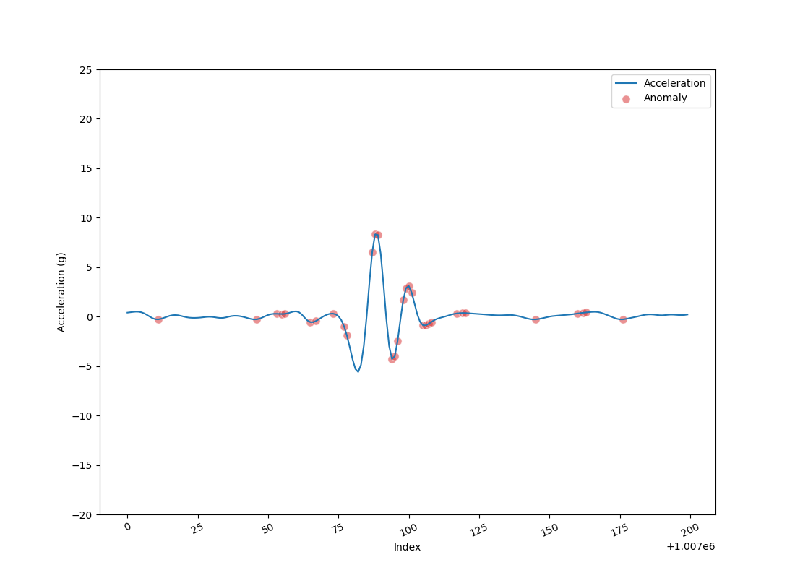
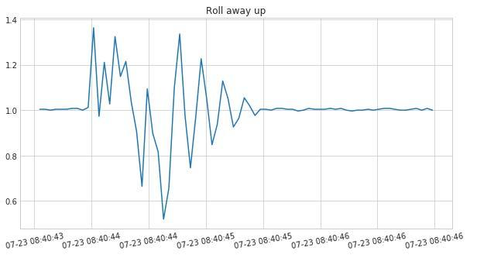
Results and Evaluation
Anomalous Values Detected by LSTM
Anomaly Detected by TSBC
Our model seemed to be best at detecting erratic jumps from positive to negative acceleration
https://www.technicalsafetybc.ca/safety-data/iot-elevating-safety#Project%20methodology
This Photo by Unknown Author is licensed under CC BY-SA

Slide 14
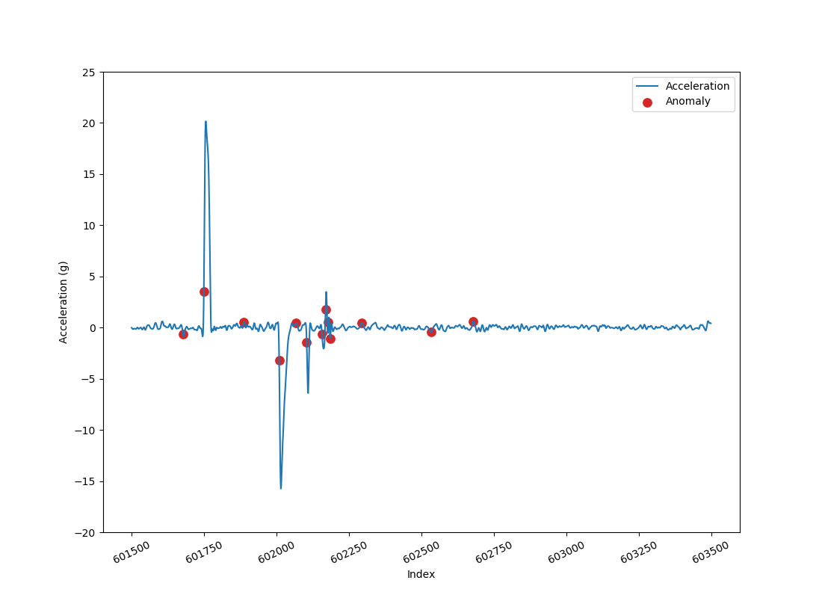
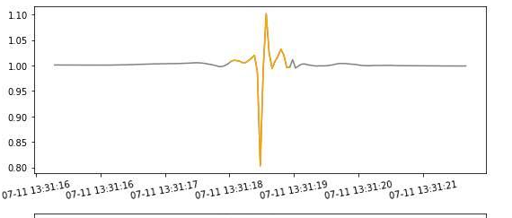
Results and Evaluation
Anomaly Detected by TSBC
Some Detections and Possible False Negatives/Positives
https://www.technicalsafetybc.ca/safety-data/iot-elevating-safety#Project%20methodology
This Photo by Unknown Author is licensed under CC BY-SA

Slide 15
For vibration (horizontal axes) - Arundo’s Anomaly Detection Toolkit (ADTK)
Generalized ESD test detector which is a univariate statistics based outlier detection
Models for Anomaly Detection
This Photo by Unknown Author is licensed under CC BY-SA

Slide 16
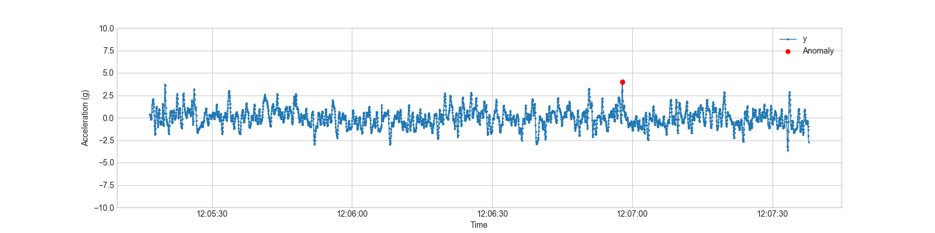
Models for Anomaly Detection
Generalized ESD Results for single secondary axis representing vibration
This Photo by Unknown Author is licensed under CC BY-SA

Slide 17
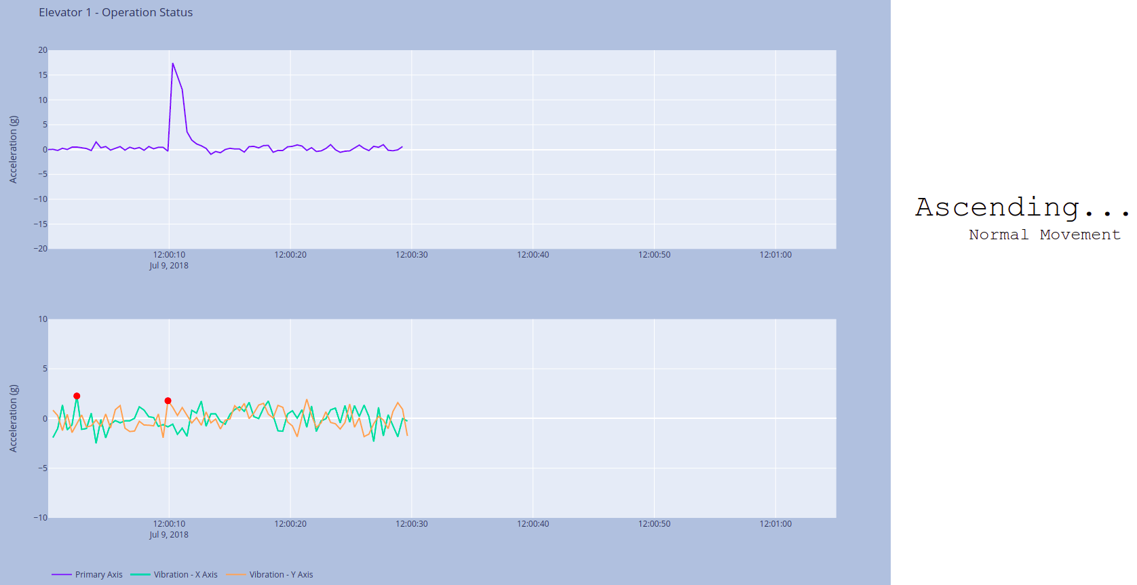

Streaming System
Data streaming system to detect anomalies - Useful for building managers/maintenance workers
This Photo by Unknown Author is licensed under CC BY-SA

Slide 18
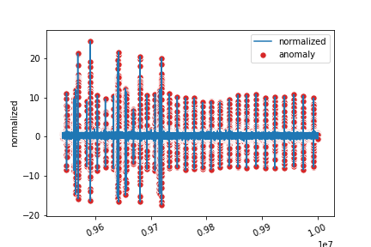
Other Models:
Random Forest
XGBoost
The above two models detected every point as an anomaly and hence were not suitable for our use case.
This Photo by Unknown Author is licensed under CC BY-SA

Slide 19
Learning involved
Working with a large dataset and IOT
Working with sensor data
Unsupervised anomaly detection
Experimenting with various time series models
This Photo by Unknown Author is licensed under CC BY-SA

Slide 20

Future Work
Can we do better???
YES!!
This Photo by Unknown Author is licensed under CC BY-SA

Slide 21
LSTM would be very useful with access to labelled anomalies via TSBC’s results or maintenance logs, etc. or hand labelling like our classmates did - Good job!
Labelled data would also make evaluation much easier and quantitative
Plotly Dash is a nice framework, but does have some limitations with high frequency streaming, so it would be nice to explore others
Future Work
This Photo by Unknown Author is licensed under CC BY-SA

Slide 22
Thank you
for a challenging project and dataset!
This Photo by Unknown Author is licensed under CC BY-SA

